Slide 1
Breadth-First Search
Algorithms & Data Structures
ITCS 6114/8114
Dr. Dewan Tanvir Ahmed
Department of Computer Science
University of North Carolina at Charlotte

Slide 2
Outline and Reading
Breadth-first search (§6.3.3)
Algorithm
Example
Properties
Analysis
Applications
DFS vs. BFS (§6.3.3)
Comparison of applications
Comparison of edge labels

Slide 3
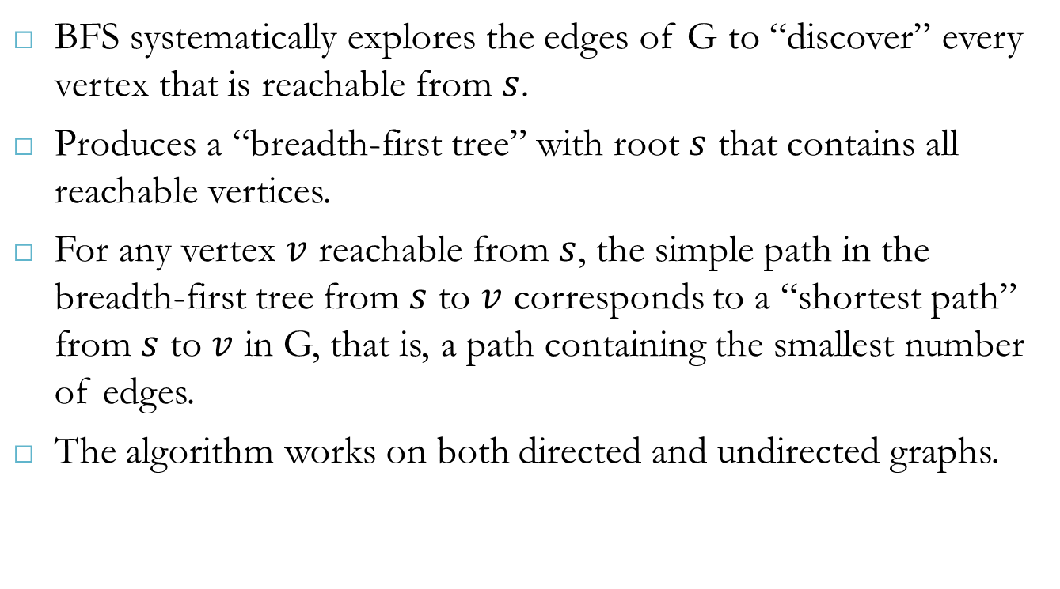
Breadth-First Search (BFS)
BFS systematically explores the edges of G to “discover” every vertex that is reachable from $s$.
Produces a “breadth-first tree” with root $s$ that contains all reachable vertices.
For any vertex $v$ reachable from $s$, the simple path in the breadth-first tree from $s$ to $v$ corresponds to a “shortest path” from $s$ to $v$ in G, that is, a path containing the smallest number of edges.
The algorithm works on both directed and undirected graphs.

Slide 4
Breadth-First Search
Breadth-first search (BFS) is a general technique for traversing a graph
A BFS traversal of a graph G
Visits all the vertices and edges of G
Determines whether G is connected
Computes the connected components of G
Computes a spanning forest of G
BFS on a graph with n vertices and m edges takes O(n + m ) time
BFS can be further extended to solve other graph problems
Find and report a path with the minimum number of edges between two given vertices
Find a simple cycle, if there is one

Slide 5
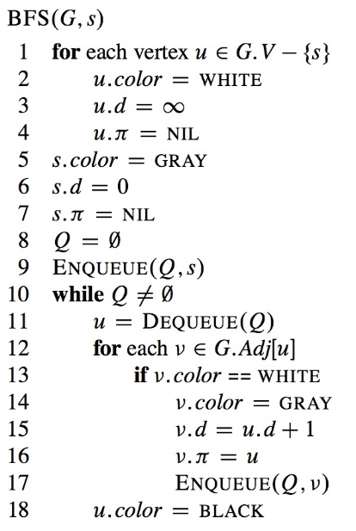
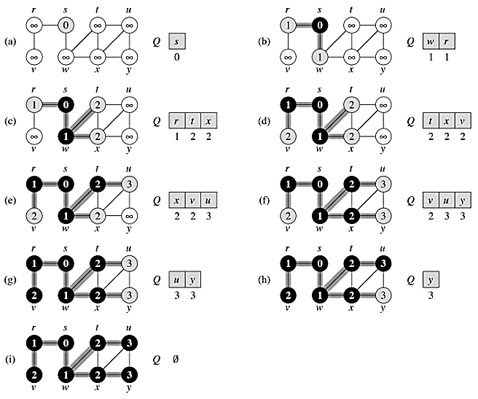
BFS Algorithm

Slide 6
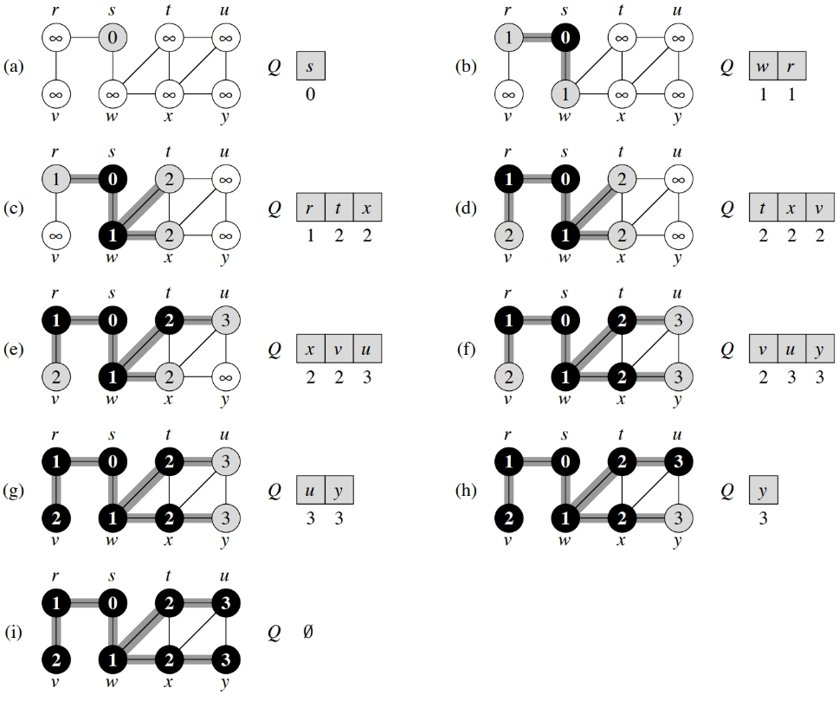
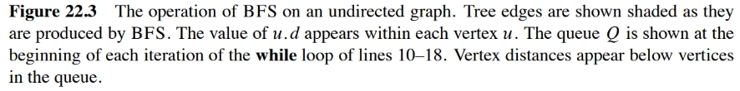
BFS Algorithm

Slide 7
BFS - Analysis
After initialization, breadth-first search never whitens a vertex, and thus the test in line 13 ensures that each vertex is enqueued at most once, and hence dequeued at most once.
The operations of enqueuing and dequeuing take O(1) time, and so the total time devoted to queue operations is O(V). Because the procedure scans the adjacency list of each vertex only when the vertex is dequeued, it scans each adjacency list at most once.
Since the sum of the lengths of all the adjacency lists is Θ(E), the total time spent in scanning adjacency lists is O€.
Thus the total running time of the BFS procedure is O(V+ E).
Thus, breadth-first search runs in time linear in the size of the adjacency-list representation of G.

Slide 8

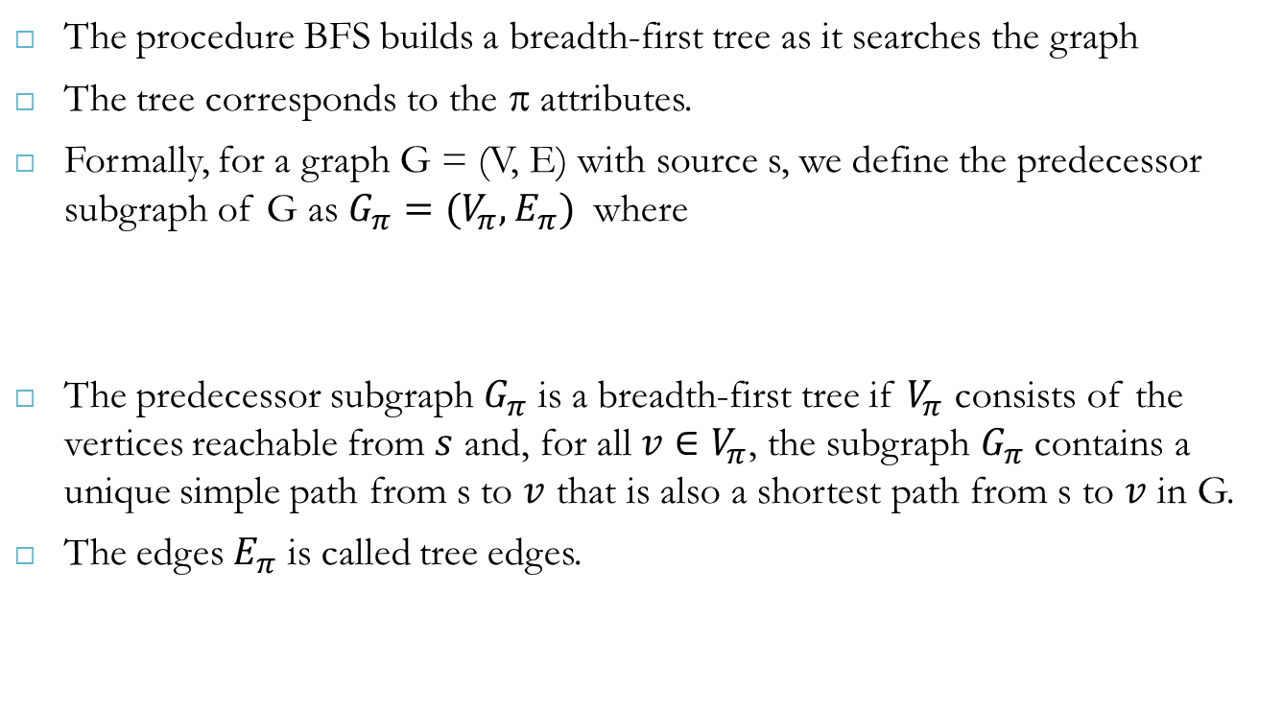
BFS Trees
The procedure BFS builds a breadth-first tree as it searches the graph
The tree corresponds to the π attributes.
Formally, for a graph G = (V, E) with source s, we define the predecessor subgraph of G as $G_{π}=(V_{π},E_{π})$ where
The predecessor subgraph $G_{π}$ is a breadth-first tree if $V_{π}$ consists of the vertices reachable from $s$ and, for all ${v∈V}_{π}$, the subgraph $G_{π}$ contains a unique simple path from s to $v$ that is also a shortest path from s to $v$ in G.
The edges $E_{π}$ is called tree edges.

Slide 9
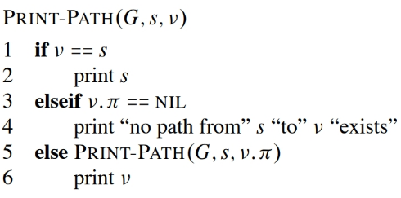
BFS
Print path

Slide 10
Applications
Using the template method pattern, we can specialize the BFS traversal of a graph G to solve the following problems in O(n + m) time
Compute the connected components of G
Compute a spanning forest of G
Find a simple cycle in G, or report that G is a forest
Given two vertices of G, find a path in G between them with the minimum number of edges, or report that no such path exists

Slide 11
DFS vs. BFS
Applications | DFS | BFS
Spanning forest, connected components, paths, cycles | √ | √
Shortest paths |  | √
Biconnected components | √

Slide 12
Reference
Algorithm Design: Foundations, Analysis, and Internet Examples. Michael T. Goodrich and Roberto Tamassia. John Wiley & Sons.
Introduction to Algorithms. Thomas H. Cormen, Charles E. Leiserson, Ronald L. Rivest, Clifford Stein.

Slide 13
Thank you!

